Slide 1
Face Image Clustering
Eldin Sahbaz

Slide 2
The Problem
Given a set of images:
Isolate any faces (i.e. crop them out)
Group like faces (clustering)
Why show any interest in this topic?
Can be used for community detection
Can be used in law enforcement
No universally agreed upon face representation/distance metric/clustering approach

Slide 3
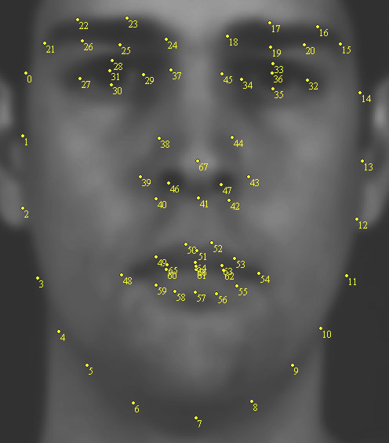
Previous Work
Charles Otto, et al. – An Efficient Approach for Clustering Face Images
Detect/extract key points using STASM Library
Nose, eyes, mouth, eye brows, etc.
Extract LBP and HOG features from key points
PCA then Linear Discriminant Analysis on combined feature vectors
Charles Otto, et al. – Clustering Millions of Faces by Identity
Extract 68 facial landmarks via DLIB ensemble of regression trees
Normalize images
CNN with 10 convolutional layers with a 3x3 filter
Construct K Neighbor graph
Rank order clustering
Notes:
An important consideration in handling face images is that since there is no universally
agreed upon face representation or distance metric, the clustering
results depend not only on the choice of clustering algorithm,
but also on the quality of the underlying face representation
and metric.

Slide 4
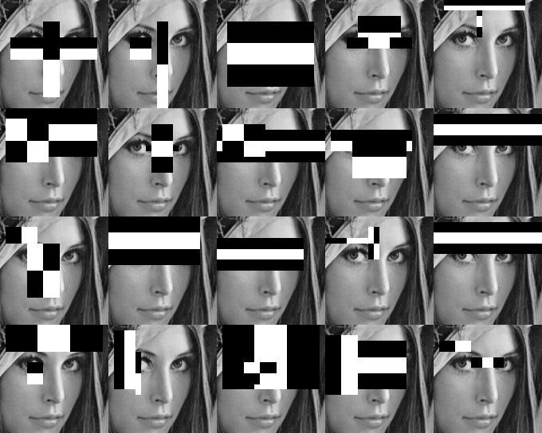
Data Pre-Processing
From a set of images, use Haar face detector to extract faces
Normalize image intensities
Resize to 100x100
Convert into a face matrix
Each sample is a column
10,000xN matrix, N = number of samples
Data set used was Yale B
Good variance of expressions and tilt

Slide 5
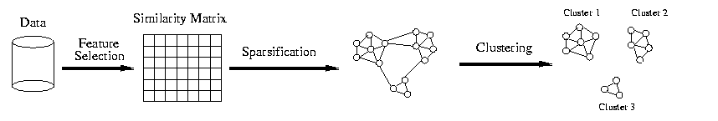
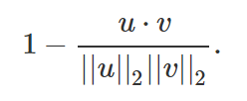
Initial Clustering
Get weights from Eigenfaces algorithm
Build an NxN distance matrix
Used Cosine distance as metric
Normalize distance matrix using Min-Max normalization
Convert distance matrix into affinity matrix
Affinity matrix = 1 – normalized distance matrix
Apply Affinity Propagation clustering algorithm to affinity matrix

Slide 6
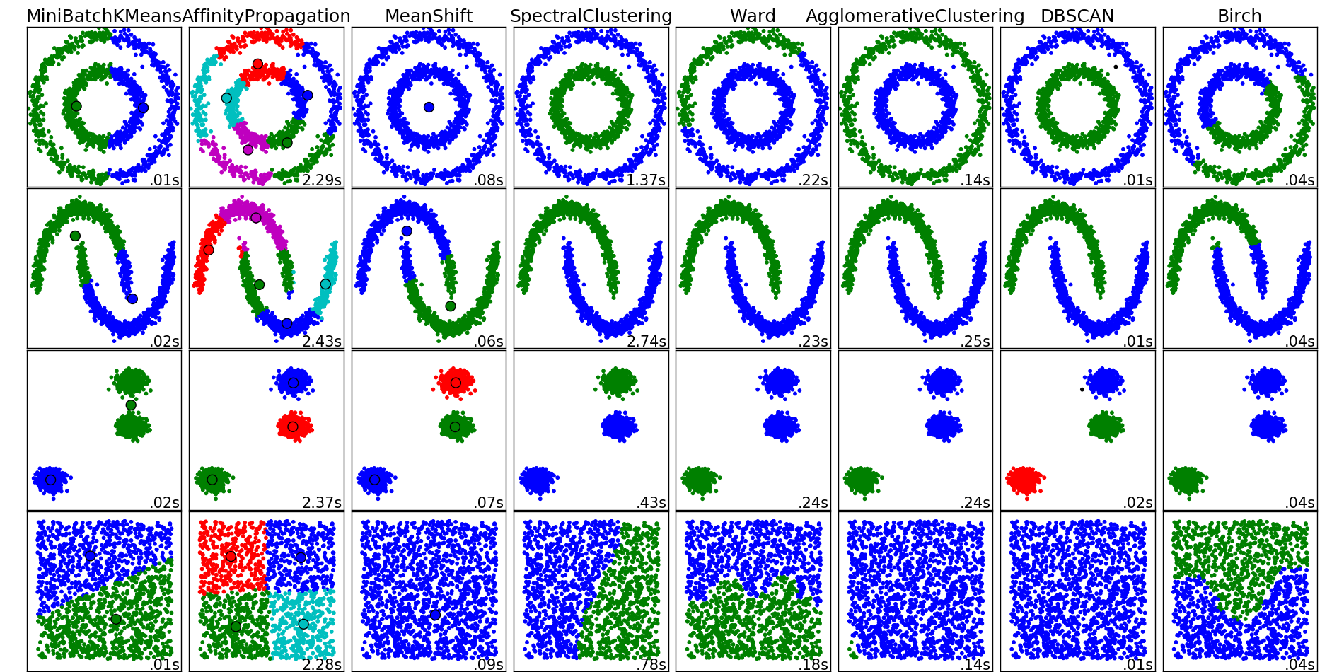

Slide 7
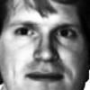
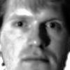





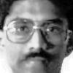



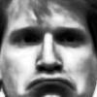
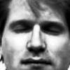
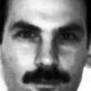
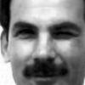
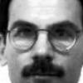
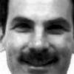
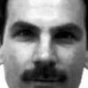
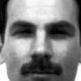
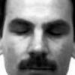
Cluster 0
Cluster 1
Cluster 2

Slide 8
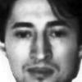

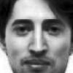
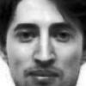


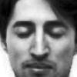

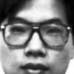
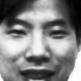
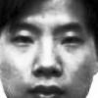
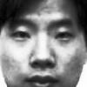
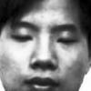
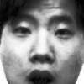
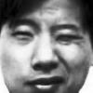

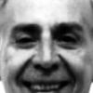
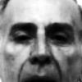
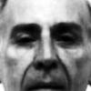
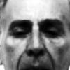
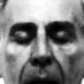
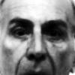
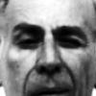
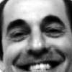
Cluster 3
Cluster 4
Cluster 5

Slide 9
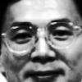
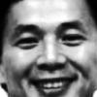
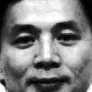
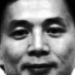
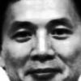
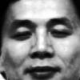
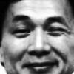
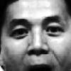





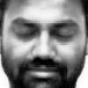



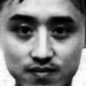
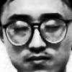
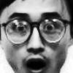
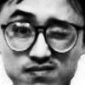
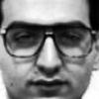
Cluster 6
Cluster 7
Cluster 8

Slide 10

























Cluster 9
Cluster 10
Cluster 11

Slide 11


























Cluster 12
Cluster 13
Cluster 14

Slide 12







Cluster 15

Slide 13



Cleaning Clusters
Clusters had varying degrees of homogeneity
Two pass algorithm
Remove any outlying clusters
$$X_{i}=\frac{1}{N−1}\sum_{i ∈ C}{AffinityMatrix\left[i,:\right][:, i]}, N=number of points in cluster$$
Compute z-scores of X
Remove any clusters with z-scores above 1 or below -1
Optimize purity
Remove any outlying images
Compute silhouette score of each sample
Compute z-scores of silhouette scores
Remove any samples with z-scores above 1 or below -1

Slide 14

Cluster 2
Cluster 3
Cluster 4

Slide 15
Cluster 6
Cluster 7
Cluster 9

Slide 16
Cluster 10
Cluster 11
Cluster 12

Slide 17
Cluster 14
Cluster 15

Slide 18
Future Work
Test other face detection algorithms
DLIB
STASM
Test other clustering algorithms
Chameleon
RBM
SOM
Test other means of anomaly detection
SSE with Median face
Scikit-Learn’s Novelty and Outlier Detection
Test on multiple data sets
Labeled Faces in the Wild
YouTube Faces

